Slide 1
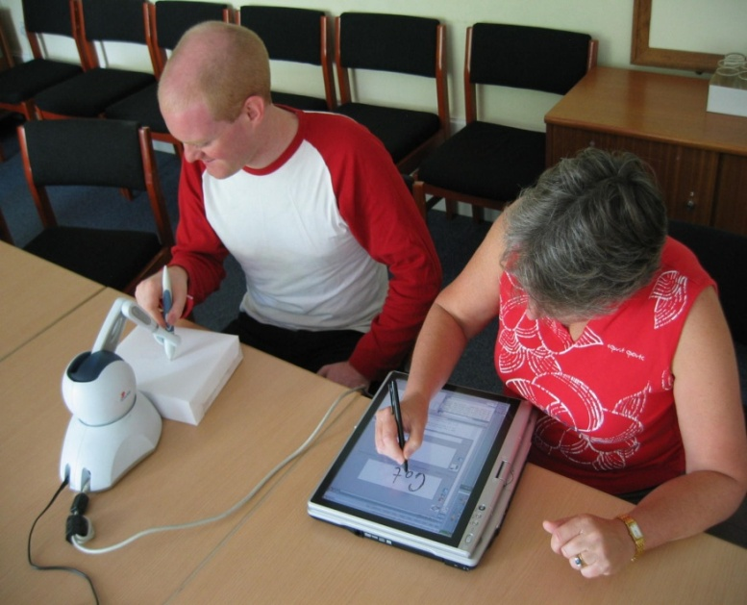
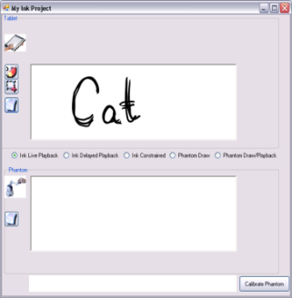
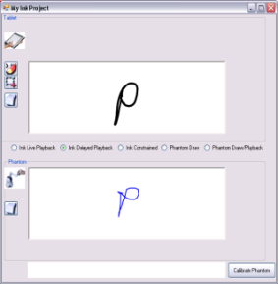
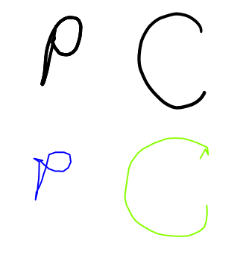
McSig - A Multimodal Collaborative Handwriting Trainer for Visually-Impaired People
Beryl Plimmer
Rachel Blagojevic
Stephen Brewster & Andrew Crossan
(Glasgow)
Peter Reid – Round 2

Slide 2
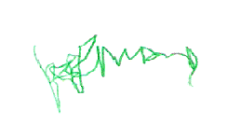
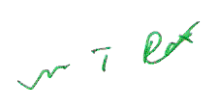
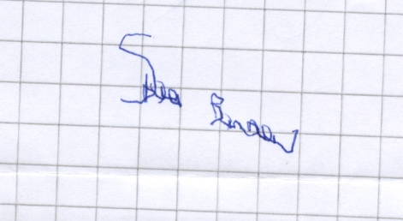
Why do Visually Impaired People Need to Write ?
Signature
  Difficult without visual feedback
  Important for Job Applications, Legal documents etc.
  One participant described her signature as ‘resembling the meanderings of an inebriated fly’
More general problem with spatial data
  Presenting
  Creating

Slide 3
Outline
Haptics Basics
How can we train users to draw a letter shape
  One solution – haptic trajectory playback
  How good are people at recalling a trajectory they’ve been dragged through
McSig
Conclusions

Slide 4
Haptic ~ Touch
Haptics interact with the user via the sense of touch by applying forces, vibrations and/or motions to the user.
Generally in a 3D space – this is not touch screen type technology which is sensing pressure on a flat 2D interface
Forces are used to either move the interaction point (user) or resist movement by the user

Slide 5

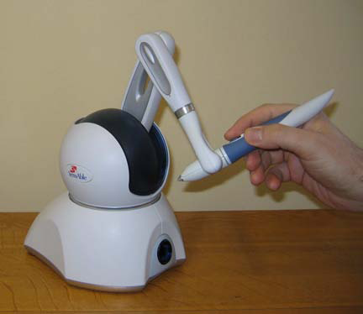

Devices
Phantom Premium ~ $40,000
Phantom Omni ~ $4,000
Novint $189 US
Promoted as a games device

Slide 6
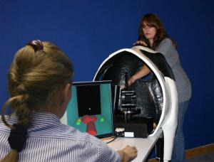
Related work
Haptic Cow – Sarah Bailey (Glasgow)
SoundBar System. Bars are represented as recessed grooves, the SoundBar is located below the bars. When a segment of the SoundBar is touched with the PHANTOM (represented by the cone shaped object), a note proportional to the height of the bar immediately above is played.
McGookin and Brewster (2006), SoundBar: exploiting multiple views in multimodal graph browsing,NordiCHI '06

Slide 7
Force Feedback as an Accessibility Aid
Our research question
  Can trajectory playback techniques be used to communicate shape and trajectory information to visually impaired people ?
  ie teach them how to write a signature or draw a triangle

Slide 8
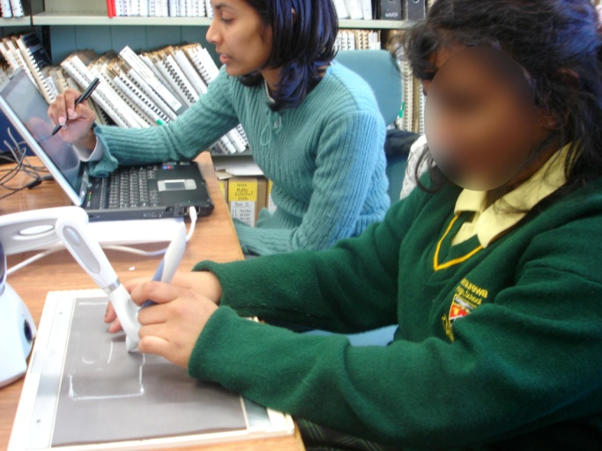
Playback Mode
Student holds PHANTOM Omni pen and feels tactile mat
Teacher uses tablet
  Teacher can move student’s pen around the character shape
  Audio pan and pitch varied with x and y
  Speech output of recognized characters

Slide 9
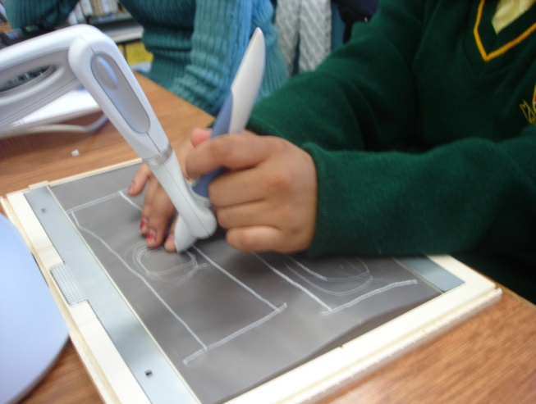
Free drawing mode
Student moves Omni pen freely within area.
Movements echoed on teacher’s screen

Slide 10
System design
Teacher can choose mode
Collaborative Playback mode
  student dragged through shape as it is drawn by teacher
Free Stencil mode
  teacher draws letter which is used as a stencil, then student explores it
  Can reduce constraining forces as
  student gets more experienced
Free Drawing mode
  Student drawing echoed on screen

Slide 11
First evaluation
1 blind adult
Feedback key to learning
  User tried to feel indentations on paper
Stencil didn’t work very well
  Added Dutch drawing board – shape is raised on the paper
  Can be felt with other hand

Slide 12
Usability testing
4 visually impaired adults (3 blind, 1 partially sighted)
Started with playback mode and then moved on to stencil
Finally drew the letter unsupported
Stencil mode hard to use
  Strengthened forces for shapes to give clearer path
  Still didn’t work very well
Audio feedback useful to some, teacher descriptions most useful
Speech feedback error prone and reduced confidence of uses
Omni pen difficult to hold, plus pressing button whilst drawing tricky
  Users not used to holding pens
  Gave some pen training before main study

Slide 13
Evaluation
Could McSig improve handwriting performance?
Task designed with teachers
  Some children almost no handwriting skills, some have good skills
  4 characters chosen after discussion with teachers
    o, c, a, d, e
Participants
  8 children 11-17 years old, read Braille, no other major disabilities
  3 partially sighted, 5 blind
4 stage study
    Familiarization with McSig, then for each letter:
      Pre-test
      McSig training
      Post-test

Slide 14
Familiarization and Pre-test
Participants could feel setup, PHANTOM, mat, PC
Spatial orientation
Drew circle, horizontal and vertical lines
Practised with the pen
In pre-test got participants to draw each letter as best they could
  Some unable to draw one or more of them

Slide 15
McSig Training and Post-test
After pre-test teacher showed participant how to draw letter in Playback mode
  Synchronous audio/haptic feedback
  Experimenter wrote shape on screen, child felt it with PHANTOM and scored line on tactile sheet
  Number of repeats based on child’s confidence
Post-test
  Got participants to draw character in free draw mode
  If participant could not draw it we trained and tested again
Time-out after 20 mins
  Stopped earlier if all letters done

Slide 16

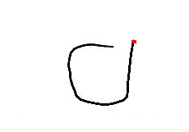
Results – partially-sighted children
Participants
  All could read enlarged print
  All had deteriorating sight but had learned to write when sight was better
  Did not write now as sight too bad
Familiarized very quickly, could all do circle, horizontal and vertical lines, no problem
One participant did all of our letters in the pre-test
Both of the others did a ‘d’ more like a mirror image ‘6’
Pre Post

Slide 17
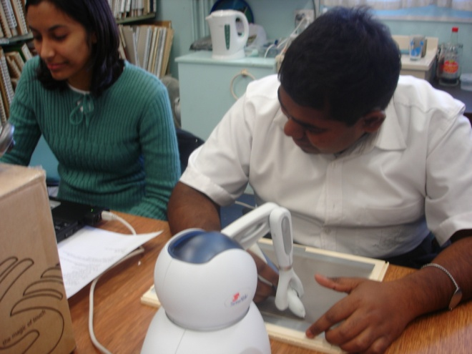
Results – partially-sighted children
One did a normal ‘e’ but did it the wrong way around
Participants had eyes close to drawing surface but did not feel drawing surface with non-dominant hand
  Wanted to use their sight
All trained quickly and did all letters correctly in post-test
  Completed within 20 mins
Politely interested but not captivated

Slide 18

Results – blind children
Participants
  5 totally blind
  One lost her sight at 3 years, others blind from birth
Familiarization took much longer
  Pressure on pen – too much/too little
Interacted with drawing space very differently
  Non-dominant hand for orientation in space
All but one could draw circle and lines
Before and after examples

Slide 19
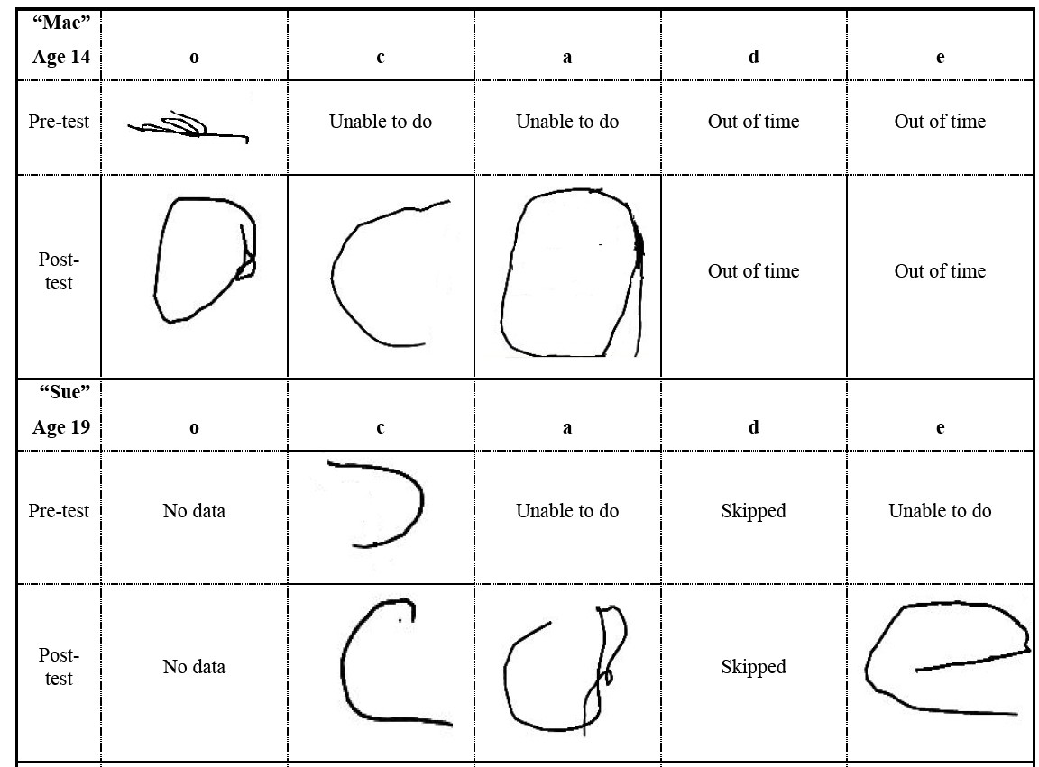
Before and after

Slide 20
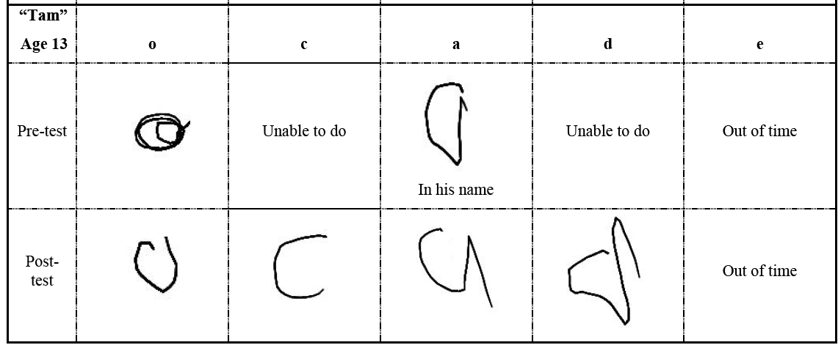
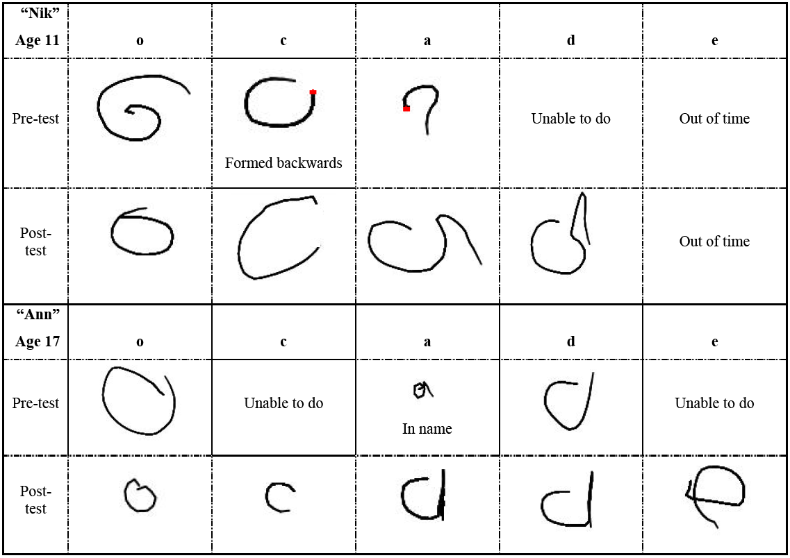

Slide 21
Results – blind children
  Skills varied a lot
    Some knew letters in their names
  Mae couldn’t create a circle in pre-test and knew no letter shapes
    Did 2 rounds of training on ‘c’ and 3 on ‘a’ before she felt she could remember them
    We timed out at 20 mins
    Did well in post-test – ‘o’, ‘c’ and ‘a’
  Sue could do ‘c’, ‘a’ and ‘e’ in post-test
  Nik and Tam showed general improvements
  Ann (sight for 2-3yrs) could do an ‘o’ and ‘a’ in pre-test
    Learned the others quickly
    Scaled letters accurately
      Training letters were around 6cm
      She drew them at 1cm in post-test

Slide 22
Discussion
Results suggest that McSig could help children to learn
  Especially blind children
  A self-teaching tool would be very useful for learning at home
    Even more challenging to design
    How do you get input to computer when both hands busy on PHANTOM/drawing surface?
    Voice is in theory possible but recognition rates would need to be fantastic!
Why didn’t stencil mode work?
  No physical representation of the letter
  Therefore an inconsistent interface

Slide 23
Second Round
Cursive handwriting and signatures
  Support move from single letters to cursive
  A signature can be created and then practised to keep it consistent over time
Refinements to software
  Button-pressing is needed for the student to write in freedraw mode in McSig1.0
  The PHANTOM pen is bulky and difficult to hold in McSig 1.0
  Lines are not available in McSig 1.0, as they are when students learn to write with lined paper.
  Inaccuracy in the trajectory playback arises from tilting of the student’s pen.
  Sudden jerking movements can occur when the student’s pen is moved to the beginning of a stroke.
  Screenshots are difficult to capture without interrupting the flow of a lesson.

Slide 24
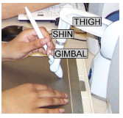
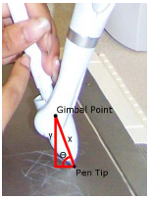
Feedback Implementation
Control point in the middle of gimbal (not tip)
Oval circles or bendy straight lines
  Hardware limitations
  dynamically correct position based on angle of pen
With this can calculate pen height so button not needed

Slide 25
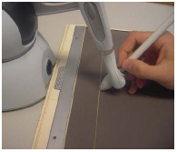

Learning to Handwrite
Lines as a spatial reference
  Physical line is best
  Calibration?
Patterns as practice?
Rubber band under mat

Slide 26


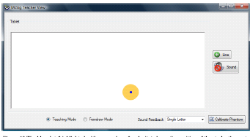

Teacher Feedback
X-axis feedback: Stereo Pan
  Small movements give minimal feedback
  Increase sensitivity around centre of drawing area
Knowing where the student’s pen is
Screen capture

Slide 27




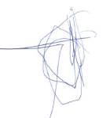
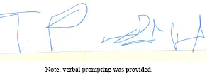
Evaluation
3 Totally Blind Kids
  10 lessons each
  before after

Slide 28
Conclusions
Hard for visually-impaired people to learn to handwrite
  Signatures difficult to learn and keep consistent
  Required for important aspects of life
McSig: a collaborative tool that allows a teacher to guide a student to handwrite letter shapes
  Dynamic haptic and audio feedback
Can improve handwriting
Geometry is another possible application

Slide 29
Conclusions 2
With McSig visual feedback has been replaced with
  Haptic, force feedback
  Sound
  Tactile
  Publications (all on ACM)
  Plimmer, B., Crossan, A., Brewster, S. A., & Blagojevic, R. (2008, April). Multimodal collaborative handwriting training for visually-impaired people. InProceedings of the twenty-sixth annual SIGCHI conference on Human factors in computing systems (pp. 393-402). ACM.
  Reid, P., & Plimmer, B. (2008, December). A collaborative multimodal handwriting training environment for visually impaired students. In Proceedings of the 20th Australasian Conference on Computer-Human Interaction: Designing for Habitus and Habitat (pp. 195-202). ACM.
  Plimmer, B., Reid, P., Blagojevic, R., Crossan, A., & Brewster, S. (2011). Signing on the tactile line: A multimodal system for teaching handwriting to blind children. ACM Transactions on Computer-Human Interaction (TOCHI),18(3), 17. (with video)

Slide 30
McSig - A Multimodal Collaborative Handwriting Trainer for Visually-Impaired People
Peter Reid, Beryl Plimmer, Rachel Blagojevic
Stephen Brewster & Andrew Crossan

